Slide 1
Understanding UMAP
1
The Internal Workings of a State-of-the-Art
Clustering Algorithm
Abhishek Deshpande
Maharashtra Institute Of Technology, World Peace University, Pune
Soham Joshi
Vishwakarma Institute Of Technology,
Pune
Varad Deshmukh
University of Colorado Boulder
Shrirang Karandikar
AlgoAsylum

Slide 2
2
UNIFORM MANIFOLD APPROXIMATION and PROJECTION
UMAP is
Topological Data Analysis and Manifold Learning
Riemannian geometry inspired TDA
Well-defined, Easy-to-use Black Box
Used For
Dimensionality Reduction
Unsupervised Clustering
Supervised Dimension Reduction and Metric Learning

Slide 3
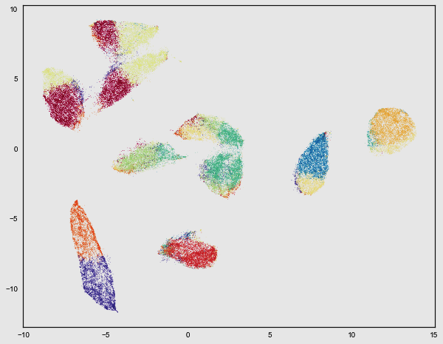
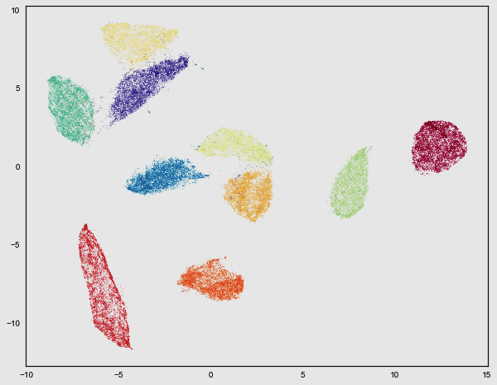
HIGHER DIMENSIONAL DATA
3
K-Means Clustering
UMAP

Slide 4
PERFORMANCE COMPARISON
4
Common Clustering Algorithms
T-SNE vs UMAP
Principal Component Analysis
K-means Clustering
T-SNE
Data
MNIST
Fashion MNIST
Google News
Dimensions
784
784
200,000
UMAP
98 sec
78 sec
14 Min
T-SNE
22 Min
15 Min
4 Hours 30 Min

Slide 5
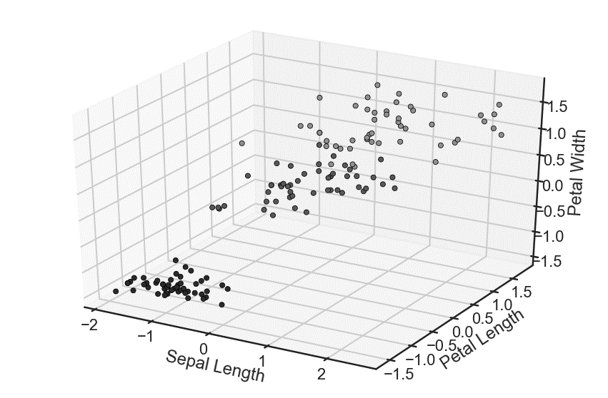
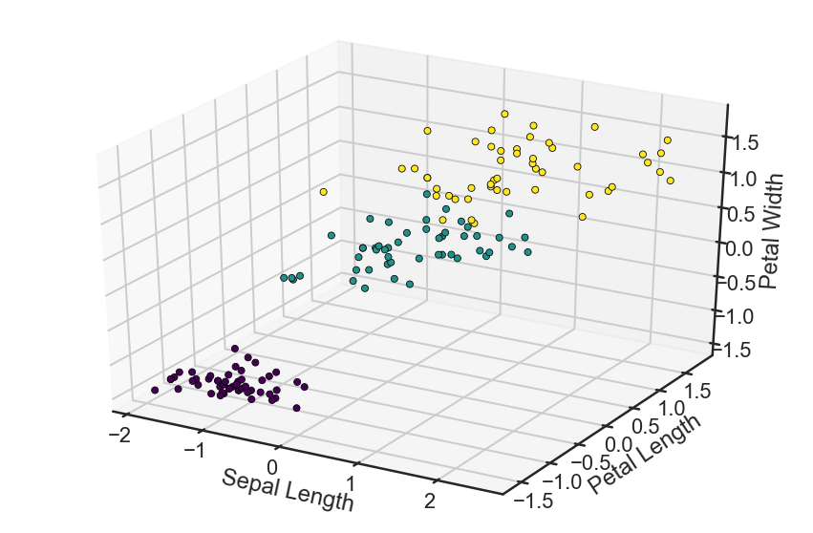
IRIS DATASET
5
3 Clusters: Species of Flowers
4 Dimensions
150 data-points

Slide 6
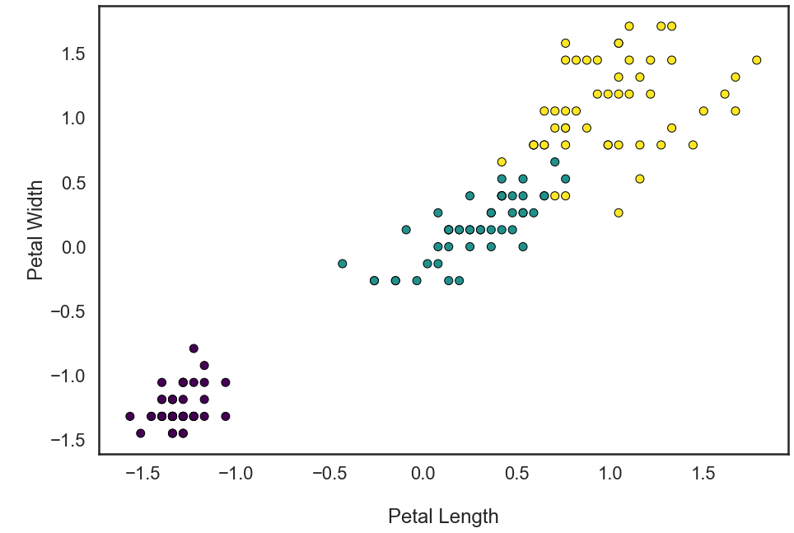
IRIS DATASET PROJECTION
6
3 Clusters: Species of Flowers
4 Dimensions
150 data-points

Slide 7
UMAP
Fuzzy Simplicial Sets
Graph Generation
Force Directed Layout
Final Output
7

Slide 8
UMAP
Fuzzy Simplicial Sets
8
Graph Generation
Force Directed Layout
Final Output
Identify the n nearest neighbors
Plot sets encompassing neighbors
Fuzzy circles such that weight is from 0 to 1

Slide 9
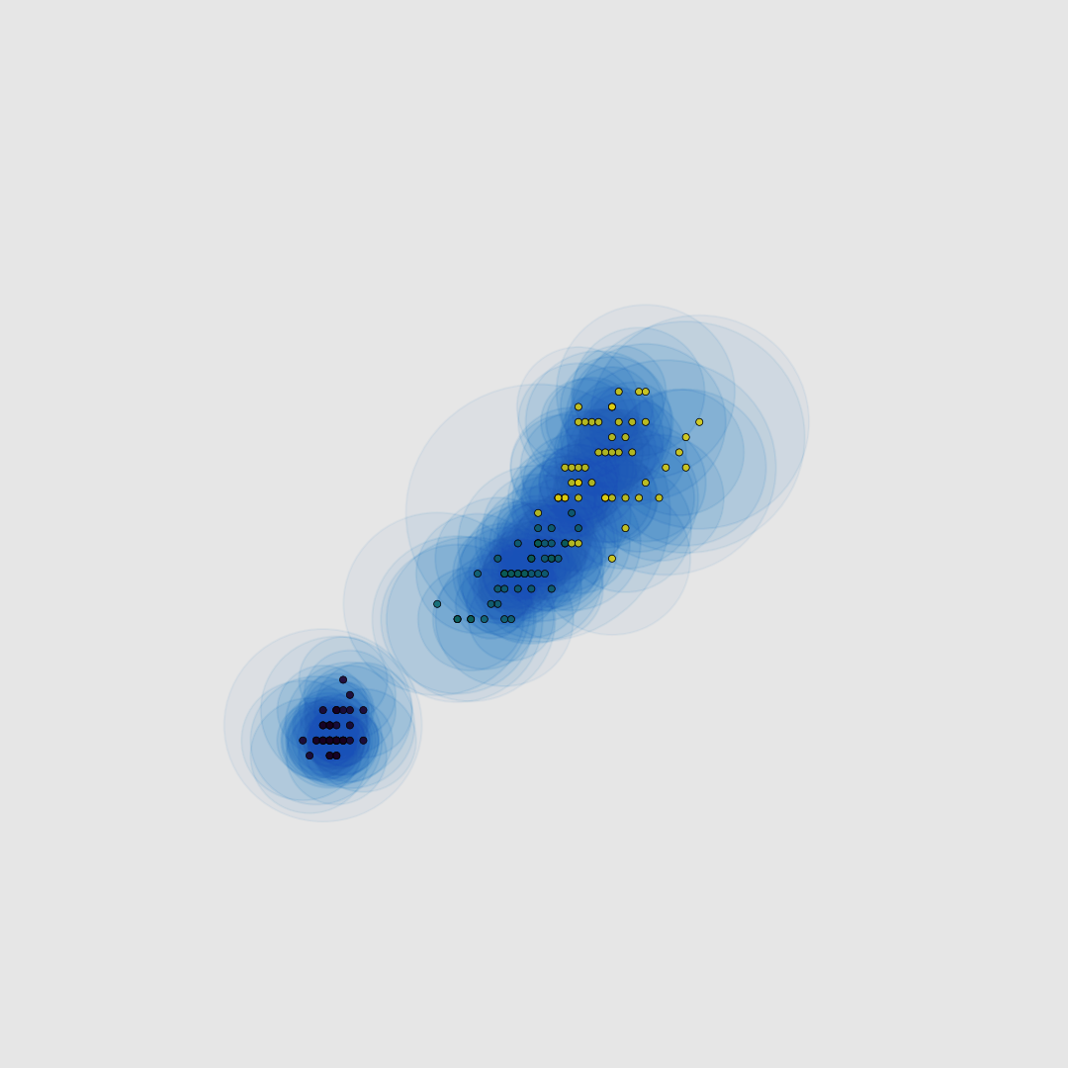
FUZZY SIMPLICIAL SETS
9
N_NEIGHBORS = 5
If the point is relatively isolated,
A larger circle is needed to cover n
A smaller circle is formed in dense areas
As more points are in close proximity

Slide 10
UMAP
Fuzzy Simplicial Sets
10
Graph Generation
Force Directed Layout
Final Output
Points are connected with the n neighbors inside the fuzzy sets
Edge weights are assigned using the distance metric

Slide 11
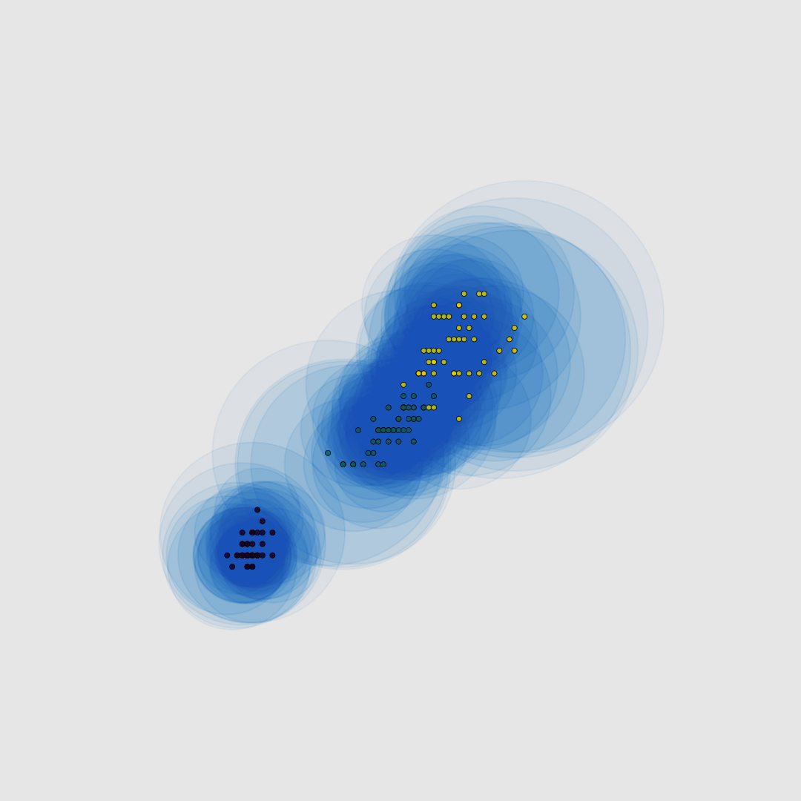
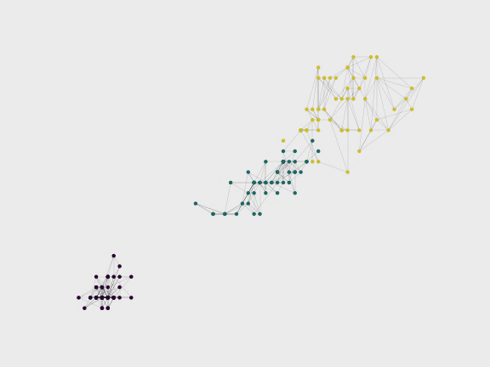
11
SIMPLICIAL GRAPHS

Slide 12
UMAP
Fuzzy Simplicial Sets
12
Graph Generation
Force Directed Layout
Final Output
Projection of the graph on a 2-dimensional space
Attraction and repulsion equations help in placement of points

Slide 13
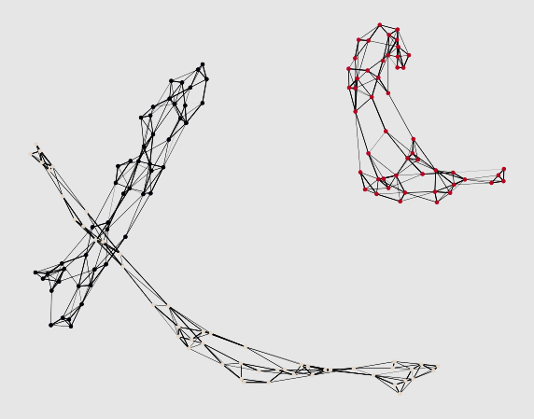
13
FORCE DIRECTED LAYOUT
Not only do we have the connection between nodes but we can define forces based on the connection

Slide 14
UMAP
Fuzzy Simplicial Sets
14
Graph Generation
Force Directed Layout
Final Output
Force Directed Layout is mapped to 2 dimensions
Affected by two main parameters: n_neighbors min_dist

Slide 15
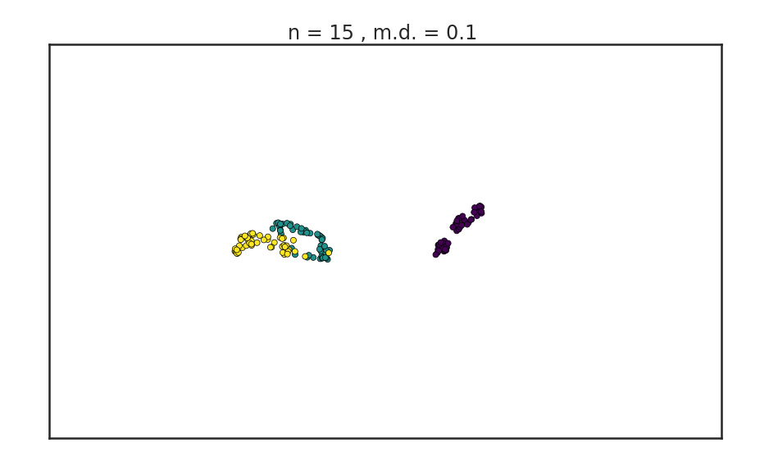
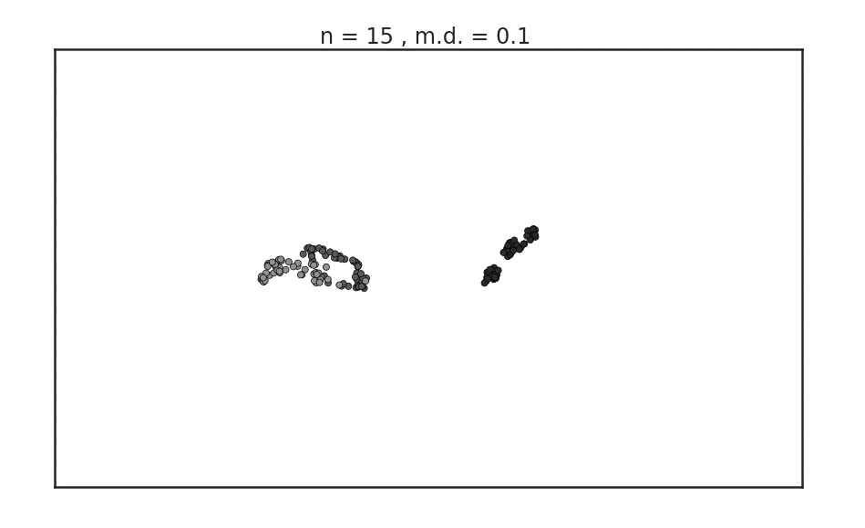
15
FINAL OUTPUT

Slide 16
UMAP
Fuzzy Simplicial Sets
16
Graph Generation
Force Directed Layout
Final Output
N_neighbors

Slide 17
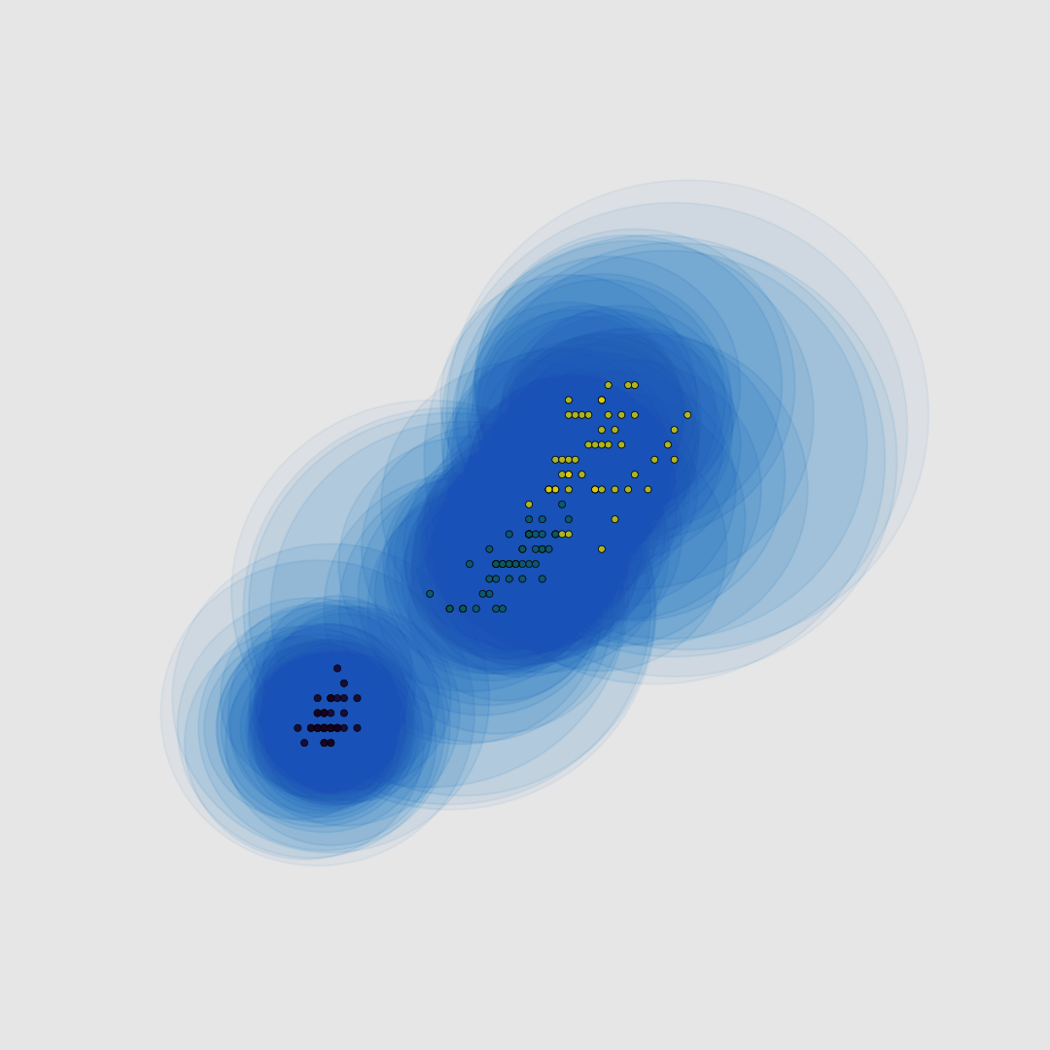
FUZZY SIMPLICIAL SETS
17
N_NEIGHBORS = 5
N_NEIGHBORS = 30

Slide 18
UMAP
Fuzzy Simplicial Sets
18
Graph Generation
Force Directed Layout
Final Output
N_neighbors

Slide 19
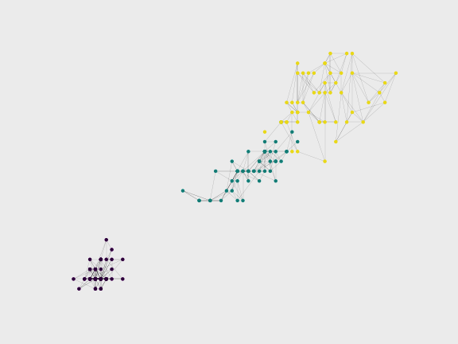
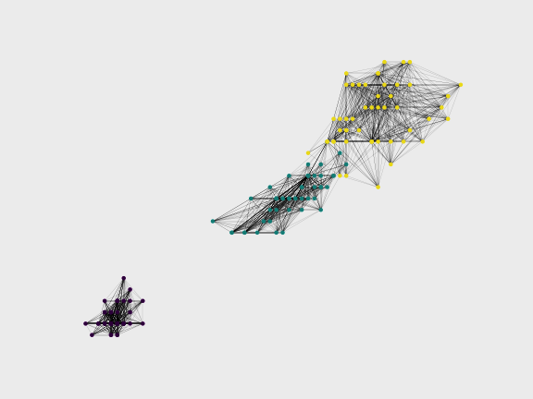
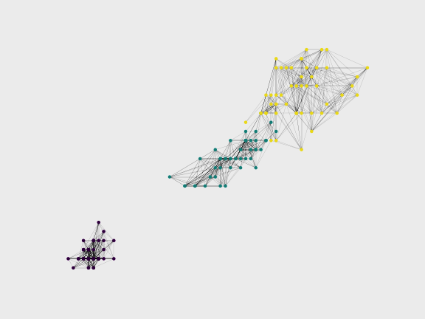
19
SIMPLICIAL GRAPHS
N = 15
N = 30
N = 5

Slide 20
UMAP
Fuzzy Simplicial Sets
20
Graph Generation
Force Directed Layout
Final Output
Min_dist
N_neighbors

Slide 21
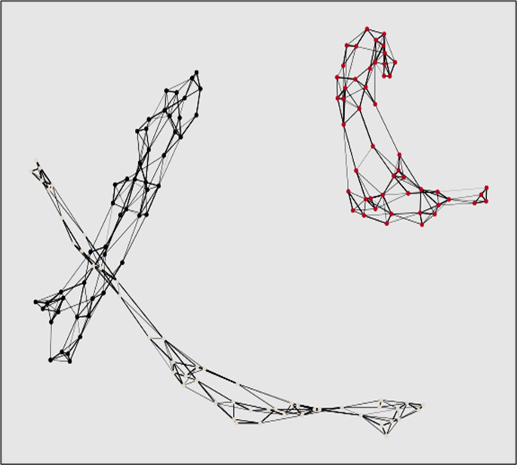
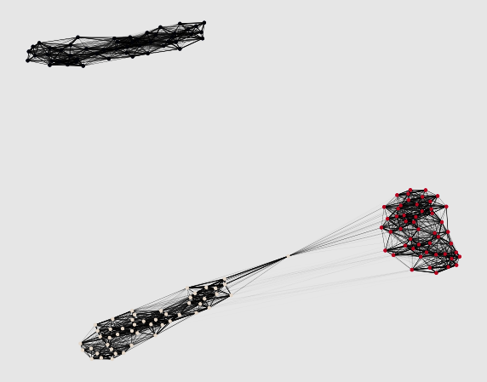
21
FORCE DIRECTED LAYOUT
N = 5
N = 30
Increasing N creates edges between previously disconnected clusters

Slide 22
UMAP
Fuzzy Simplicial Sets
22
Graph Generation
Force Directed Layout
Final Output
Min_dist
N_neighbors

Slide 23
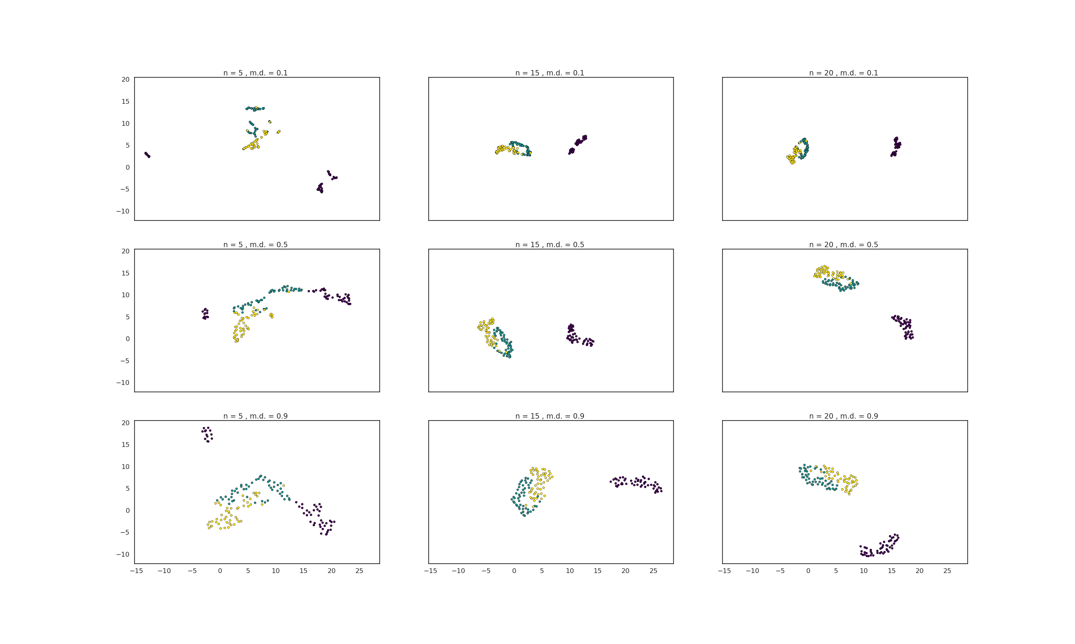
PARAMETER OVERVIEW
23
min_dist = 0.1
MIN_DIST
min_dist = 0.5
min_dist = 0.9
N = 5
N = 15
N = 20
N_NEIGHBORS

Slide 24
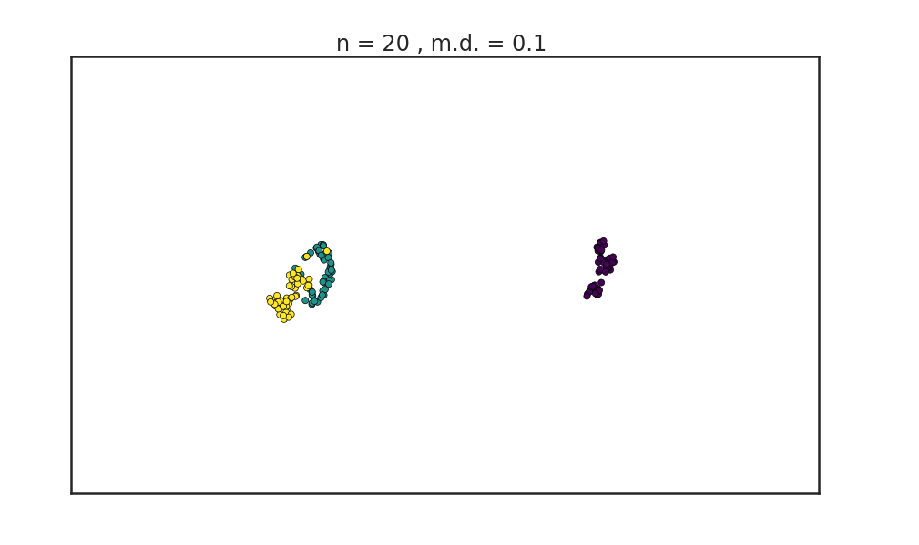
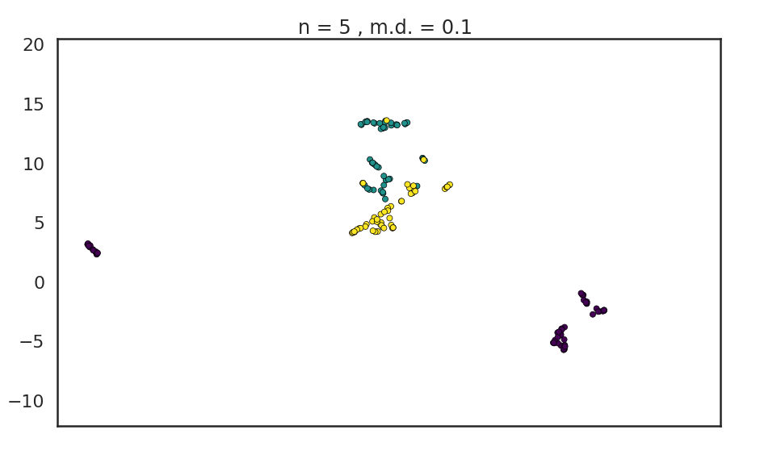
PARAMETER OVERVIEW
24
Default number of neighbors
More neighbors have ensured close packing of similar clusters
For low number of neighbours, data is over-clustered
Some clusters are still not well connected
By Force Directed Placements, fallacious clusters are placed away from the rest
More neighbors start to merge clusters
This can be changed with the min_dist parameter

Slide 25
PARAMETER OVERVIEW
25
min_dist = 0.1
MIN_DIST
min_dist = 0.5
min_dist = 0.9
N = 5
N = 15
N = 20
N_NEIGHBORS

Slide 26
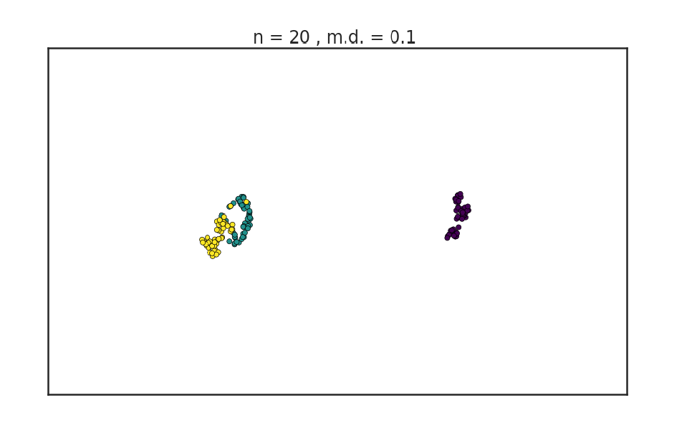
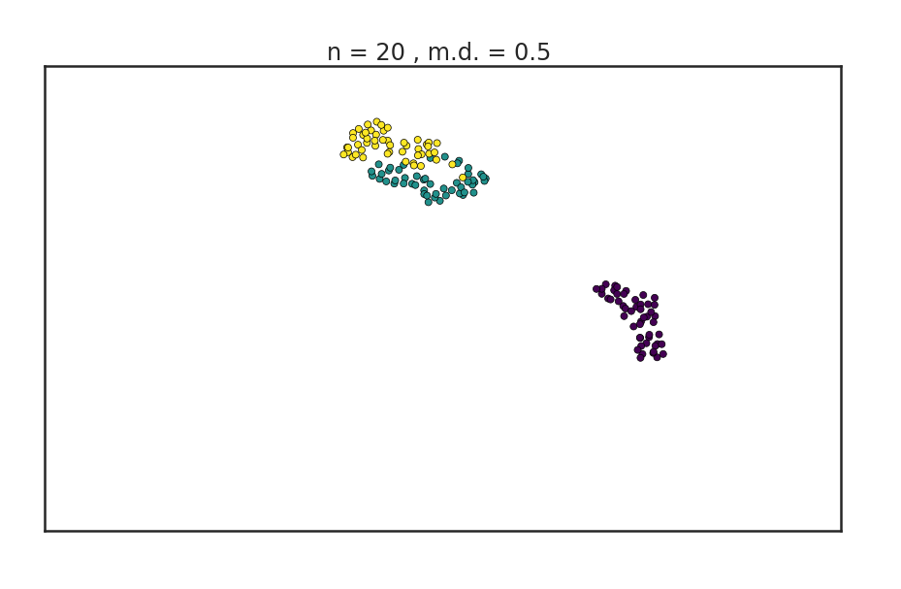
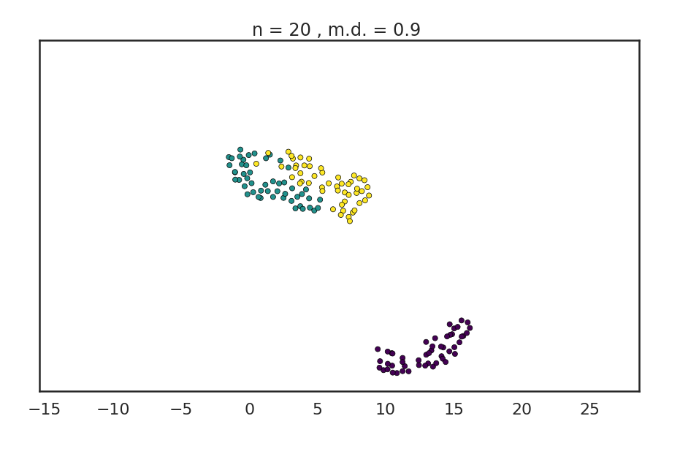
PARAMETER OVERVIEW
26
There is a significant error introduced
Finer separation of data can be achieved
Reducing the density of packing reduces amount of points which can be wrongly classified
This also loosens up the tightly classified third cluster
Downside of increasing:
Weak inter cluster connection can be misrepresented as separate clusters

Slide 27
PARAMETER OVERVIEW
27

Slide 28
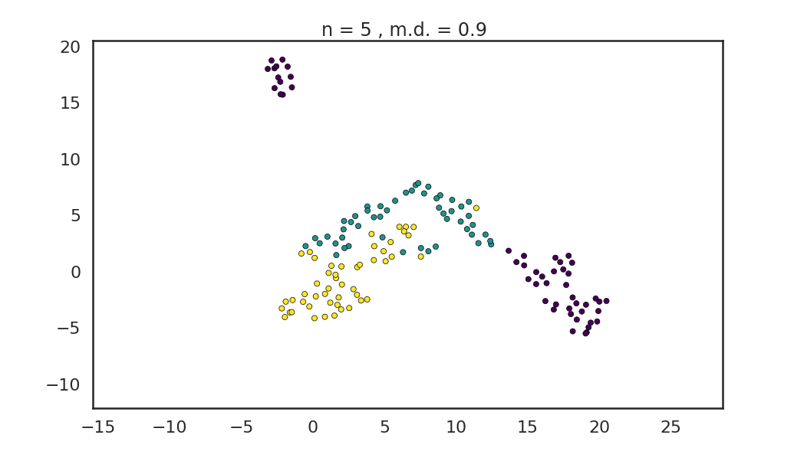
THINGS NOT TO DO
28
Low n_neighbors
High min_dist

Slide 29
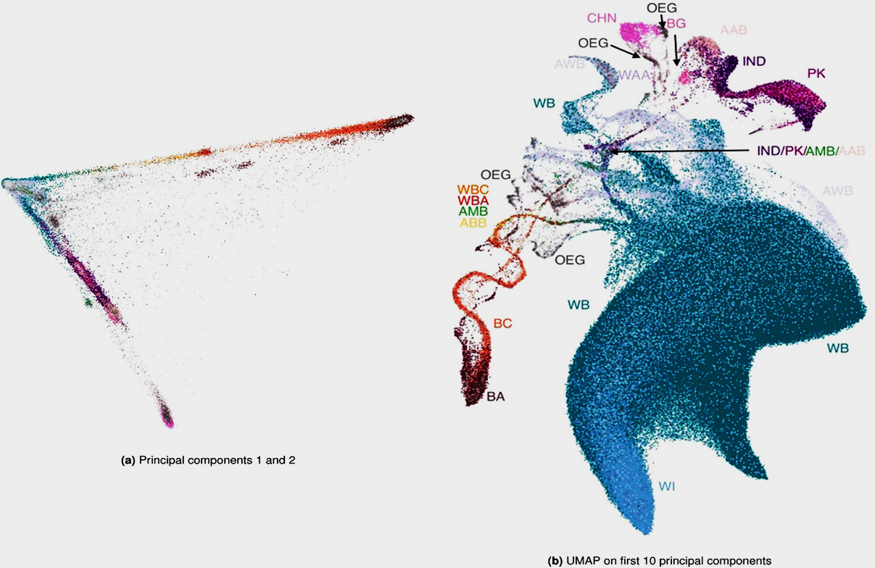
APPLICATIONS
29
Corners signify the 3 major ancestries
UK BioBank
African
Genotype data on ~500,000 individuals
10,000+ features
500k data points
European
PCA finds it difficult to place certain mixed race ethnicities or genomes into correct clusters
Asian
Revealing multi-scale population structure in large cohorts: Alex Diaz-Papkovich, Luke Anderson-Trocmé, Simon Gravel bioRxiv 423632; doi: https://doi.org/10.1101/423632

Slide 30

APPLICATIONS
30
India and Pakistan share a similar genome
Corners signify the 3 major ancestries
African
European
UMAP forms distinct clusters with similar clusters near each other
Run-time
T-SNE: 2 hours 15 min
UMAP: 14 min
Asian
British and Irish are closely related
Revealing multi-scale population structure in large cohorts: Alex Diaz-Papkovich, Luke Anderson-Trocmé, Simon Gravel bioRxiv 423632; doi: https://doi.org/10.1101/423632

Slide 31
SUMMARY
BLACK BOX
TRIAL & ERROR
HIT / MISS
UNDERSTAND
TWEAK
EFFICIENCY
31
You don’t need to know the mathematics to operate it
Having no idea about the parameters will lead to random trials
Your Chances of getting a Fruitful results are based on Pure Luck!
UMAP is a powerful algorithm based on advanced mathematics
Understand the Internals and Tweak the parameters Correctly
Efficient Usage and Better Results

Slide 32



THANKS
algoasylum abhishek-1131
sjoshi5
shrirangkarandikar
vrd1243
Does anyone have any Questions?
Slides:
UMAP: https://umap-learn.readthedocs.io/en/latest/index.html https://github.com/lmcinnes/umap
Research paper: https://www.biorxiv.org/content/10.1101/423632v2

